Slide 1
Building a Tool to Predict Damage Patterns from Meteoroid Airbursts
Anika Nath, Mark Boslough, Cathy Plesko
7/31/2025

Slide 2
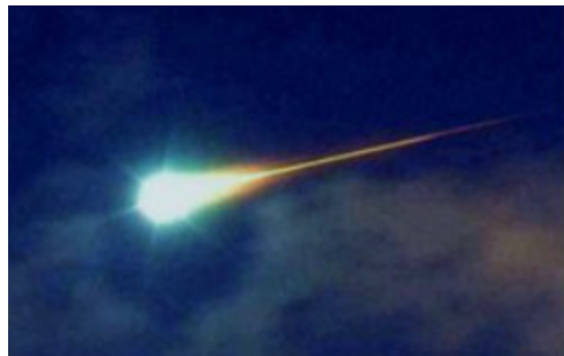
Introduction
I’m working on a web app that predicts the shape of ground damage caused by a meteoroid airburst.
When a meteoroid enters the atmosphere, it often explodes mid-air.
This is called an airburst, and it creates a shockwave that travels downwards.
Bolide entering Earth's atmosphere
Image: Thomas Grau, via Wikimedia Commons (Public Domain)

Slide 3
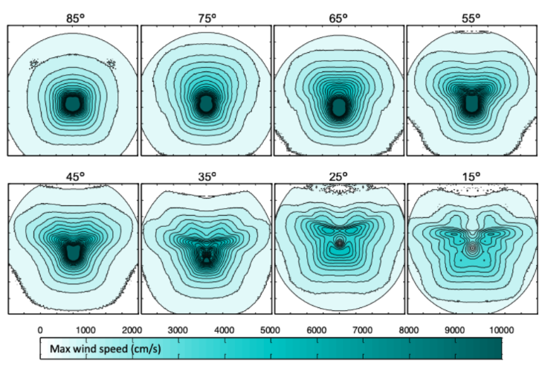
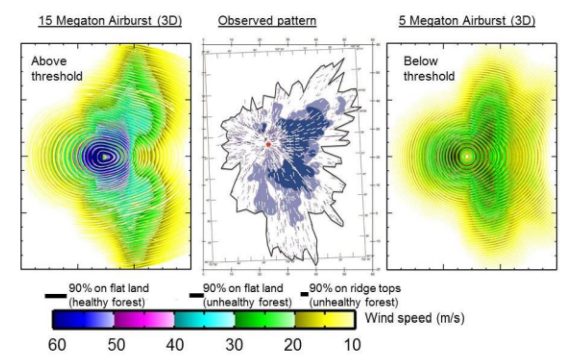
Damage Pattern
Factors such as the impact angle, speed, and height of the airburst determine the shape of the damage on the ground
Mostly circular for vertical impacts and butterfly shaped for shallow, oblique impacts
For my app, user will input these parameters
Top: Contours from 3D simulations showing blast patterns for asteroid airbursts at various entry angles. Adapted from Boslough et al. (2025), these patterns help in understanding how entry angle affects the shape of the damaged region.
Bottom: Wind speed contours from asteroid airburst simulations
Left and right: Modeled wind patterns for 15 and 5 megaton airbursts from the “FEMA Asteroid Impact Tabletop Exercise Simulations” (Boslough et al., 2015). Center: Observed forest damage pattern used for comparison. The green contour on the left was recreated manually in Desmos for this project.

Slide 4
Initial Methodology
Initially, I tried to find a relationship between input parameters and the shape of ground damage
I drew the butterfly-shaped contours manually in Desmos, an online graphing tool, using trial and error, then converted those into cartesian coordinates and plotted them in Python
I also made a KML file so I could visualize it in Google Earth

Slide 5
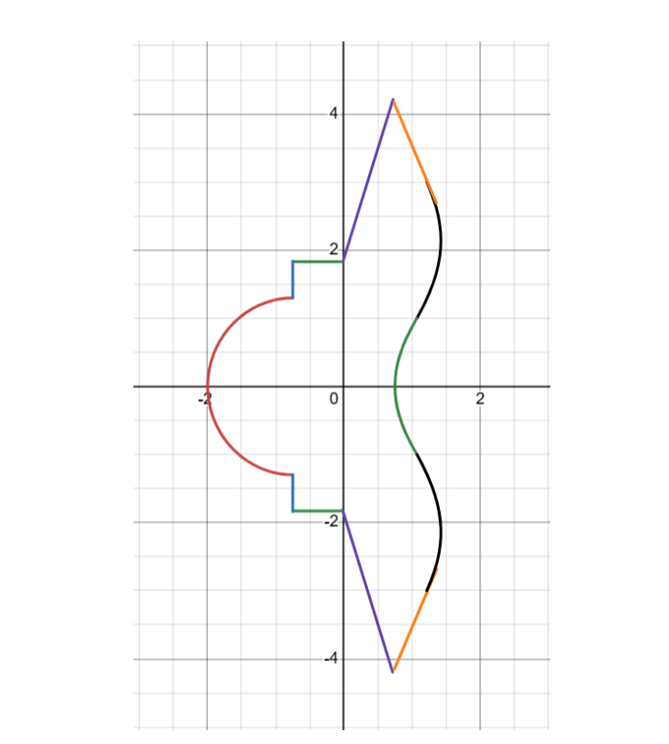
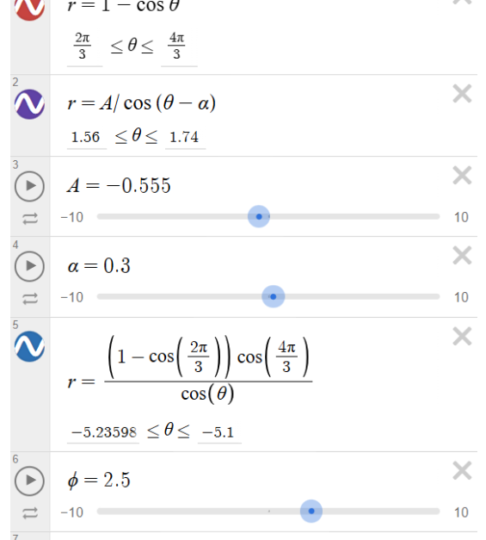
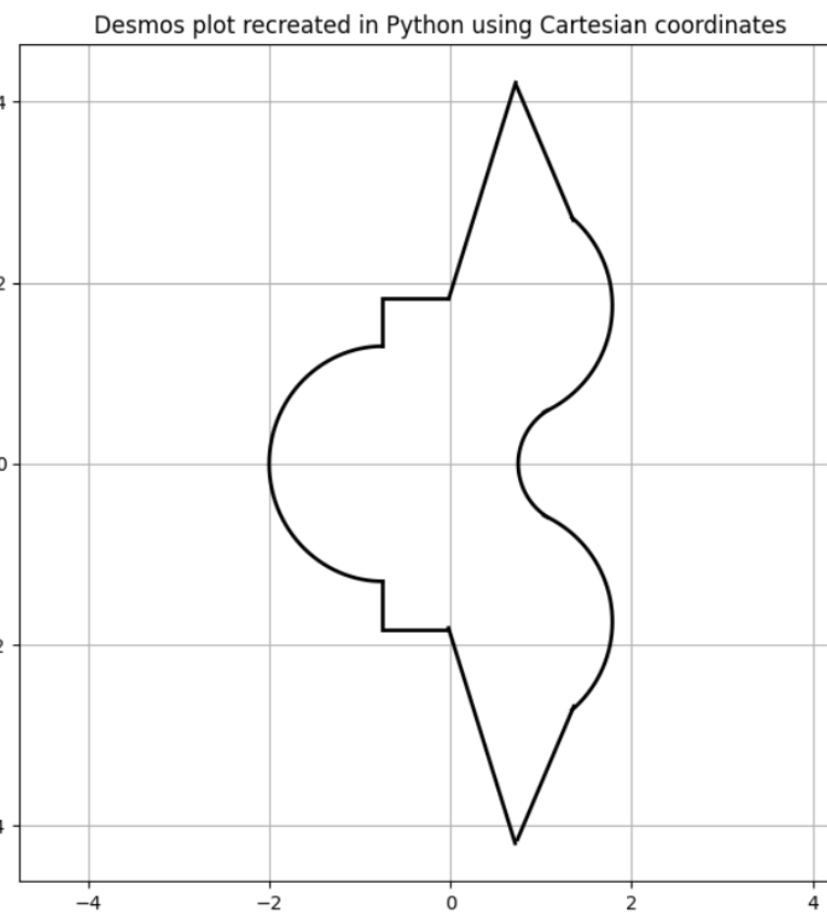
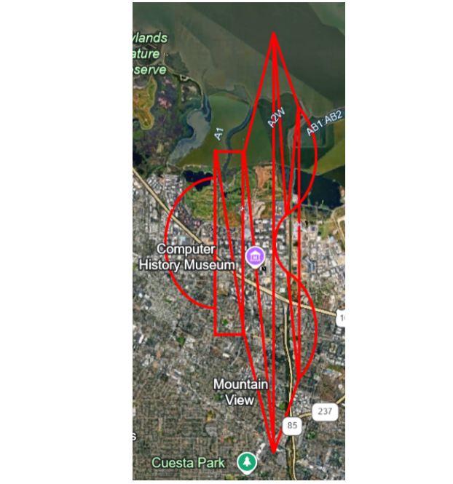
Graphs
Butterfly-shaped contour made from separate polar segments
Example equations used to build the butterfly shape
Butterfly shape in Python
Butterfly contour plotted in Google Earth using KML export

Slide 6
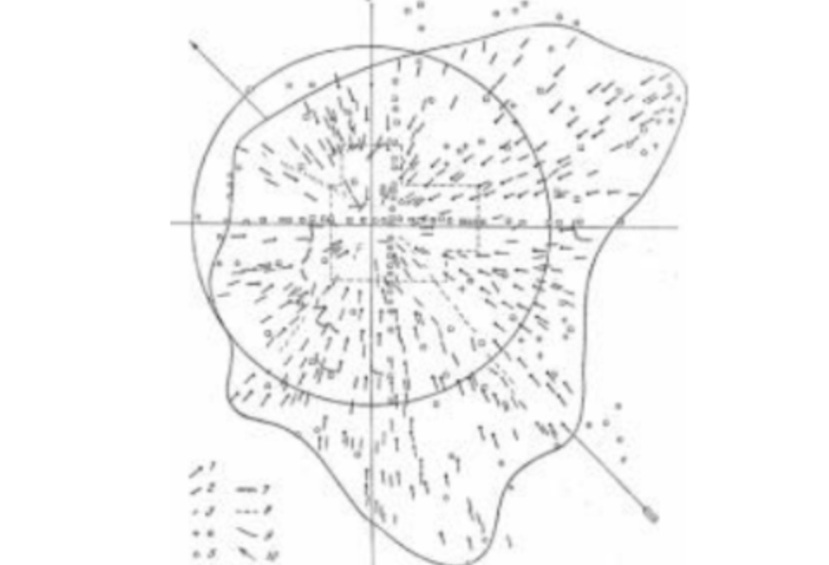
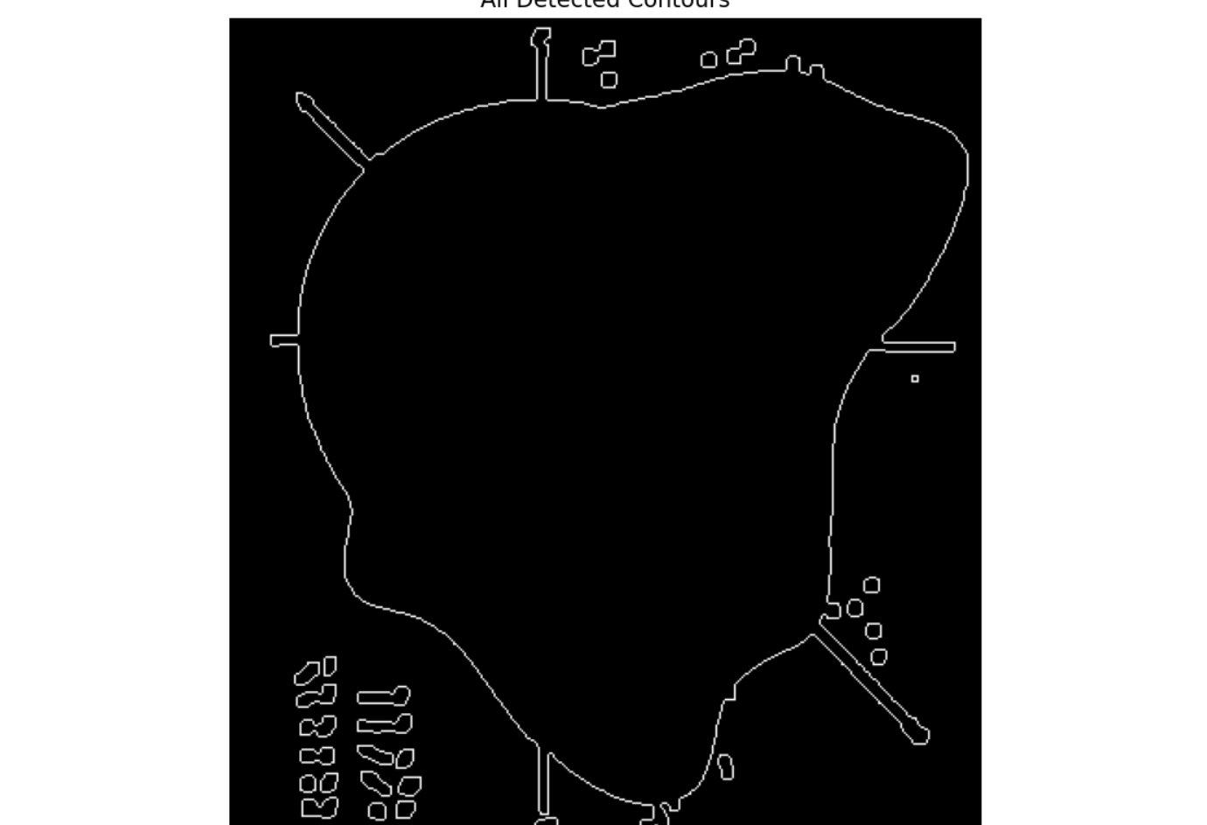
Optimizing with a Fourier Fit
Manually recreating the shapes was time-consuming and inefficient, so I used the Fast Fourier Transform to automate the fitting process
I converted each contour to a mathematical function
I did some manual cleanup to remove noise and unnecessary features
This map shows observed treefall directions and blast extent from the 1908 airburst. It was originally published by K.P. Florenskii (1963) and reproduced in later works, including Vasilyev et al. (2013).
These are the contours detected by Python from the Tunguska damage map.

Slide 7
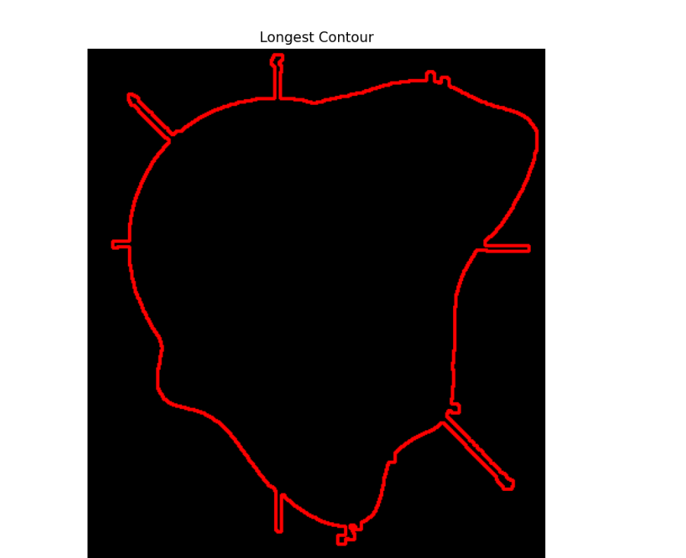
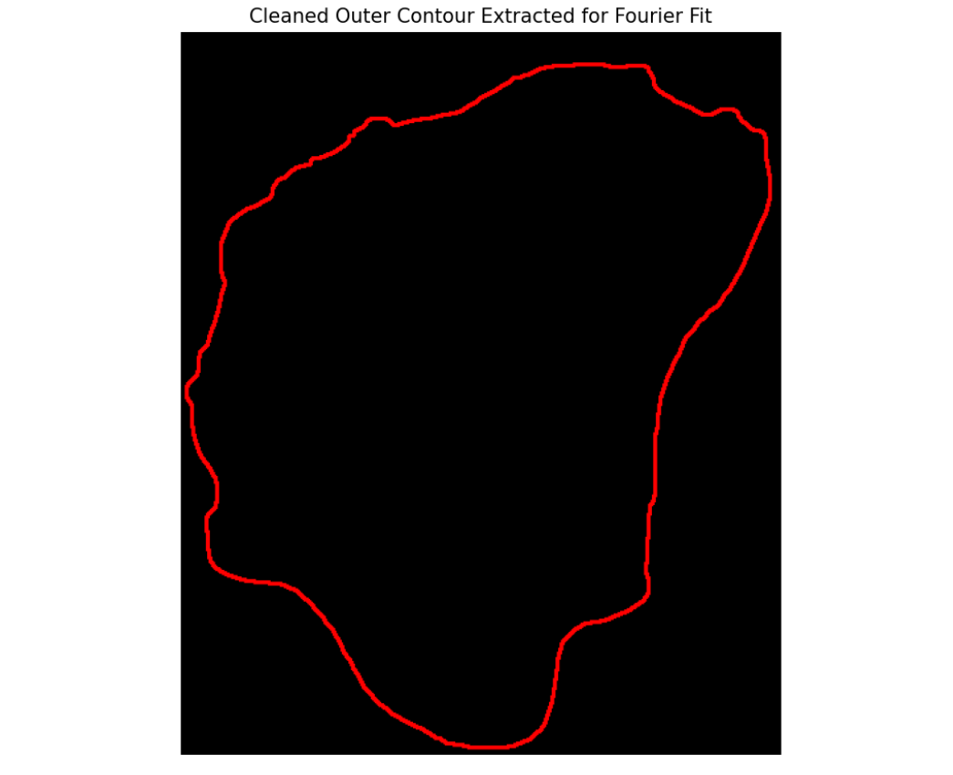
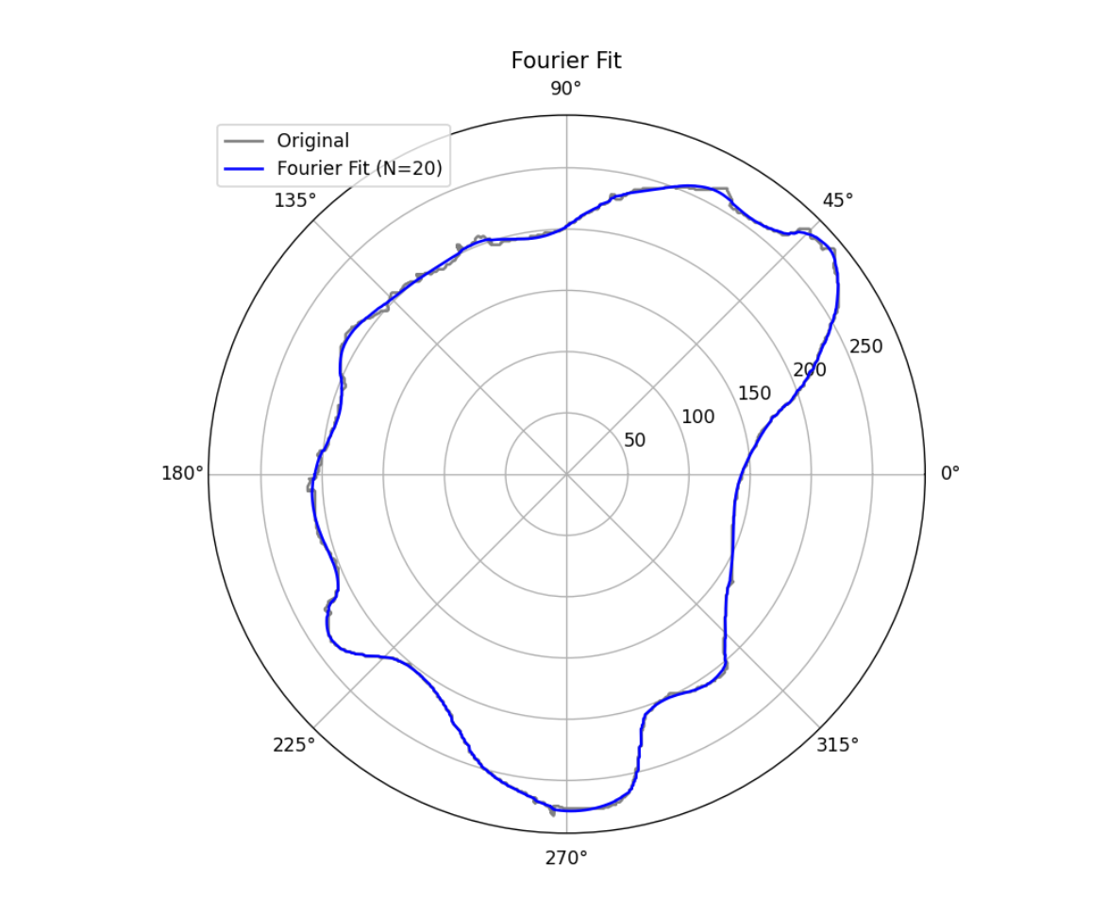
Contour and Fourier Fit
The main line is the longest contour that was detected.
Contour edited manually to match the line in the Tunguska map.
Fourier Fit using 20 terms.

Slide 8
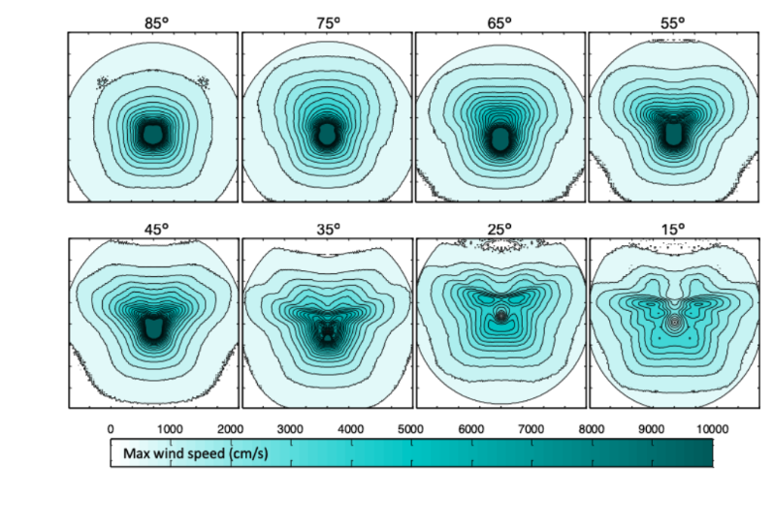
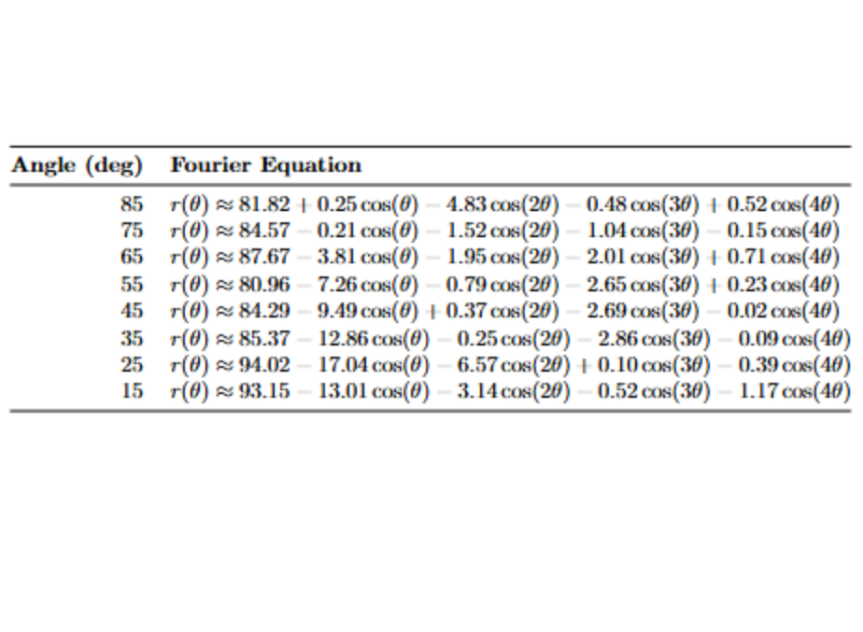
Results
I am creating a Fourier fit for each impact angle, and I’ll interpolate between them so the user can input any angle and get a predicted shape instantly
I plan to repeat this process for the other parameters too
I made a table of the Fourier Fit corresponding to the damage pattern for each angle
I did not find any pattern yet, so I’ll need to try different functions
Contours from 3D simulations showing blast patterns for asteroid airbursts at various entry angles. Adapted from Boslough et al. (2025), these patterns help in understanding how entry angle affects the shape of the damaged region.
Table showing the equation for the Fourier Fit of each angle.

Slide 9
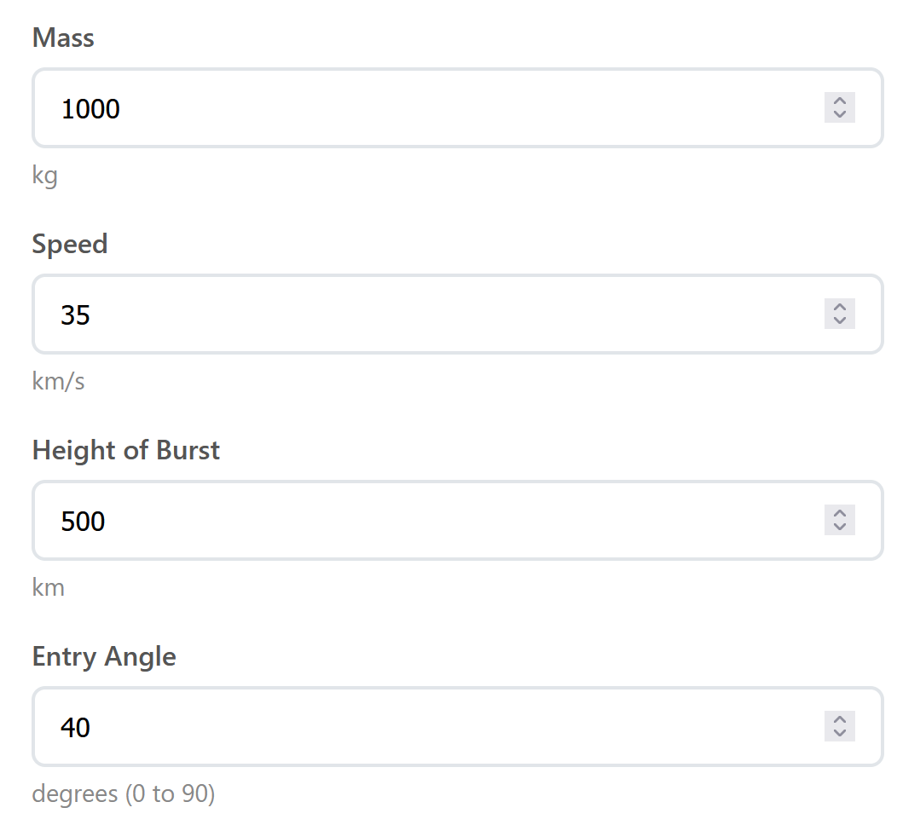
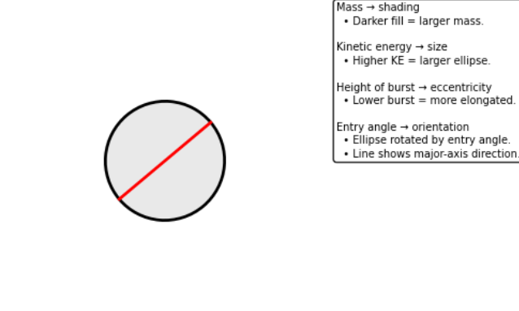
GUI
Made a mockup web-based GUI with four inputs: mass, speed, height of burst, and impact angle.
Shows a placeholder image after the user inputs those values that visualizes the inputs
Ellipse shows impact damage shape: shading = mass, size = kinetic energy, elongation = burst height, orientation = entry angle.
Here is the app: https://web-production-7fe93.up.railway.app/

Slide 10
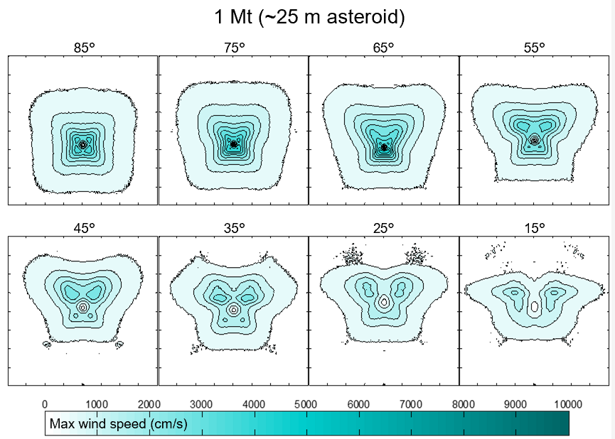
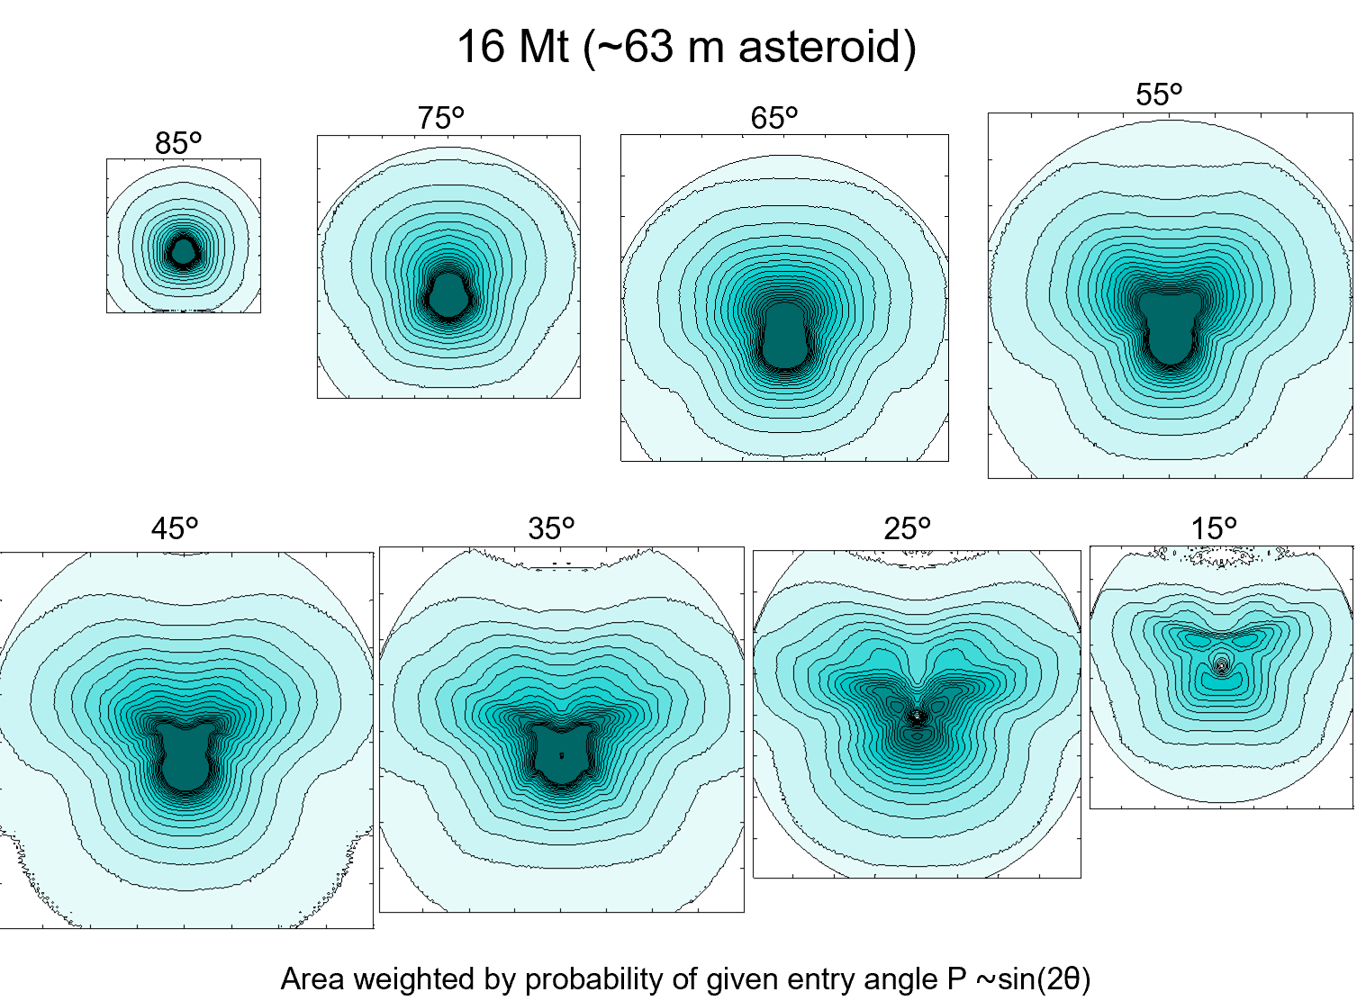
Future Work
e Work
Need to experiment with more butterfly-shaped contours to find a relationship between impact angle and shape of damage area
The goal is for the GUI to output a similar shape to these plots corresponding to the input parameters

